Slide 1
Digital Engineering 1
Lecture 2

Slide 2
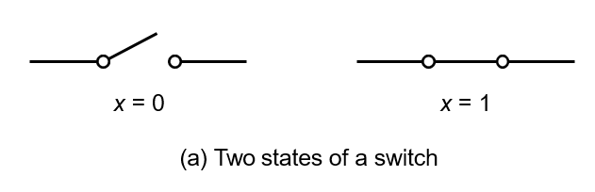
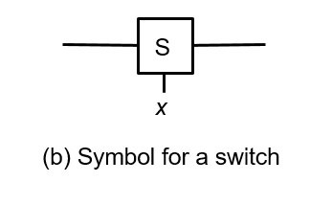
Binary Switch

Slide 3
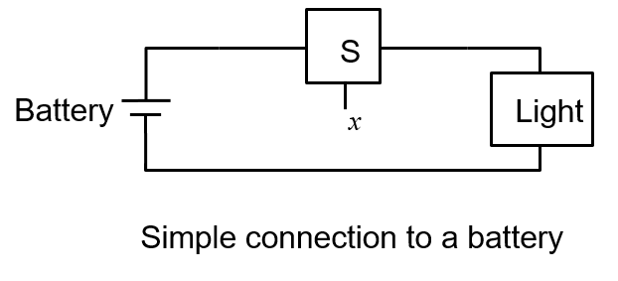
A Light Controlled by a Switch

Slide 4
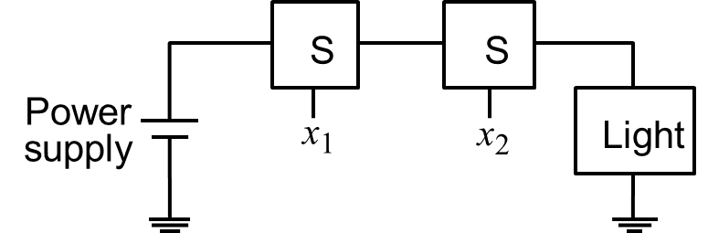
AND
The logical AND function
(series connection)

Slide 5
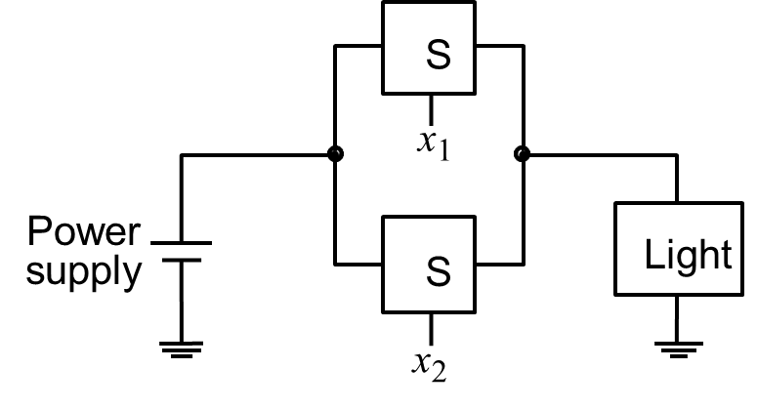
OR
The logical OR function
(parallel connection)

Slide 6
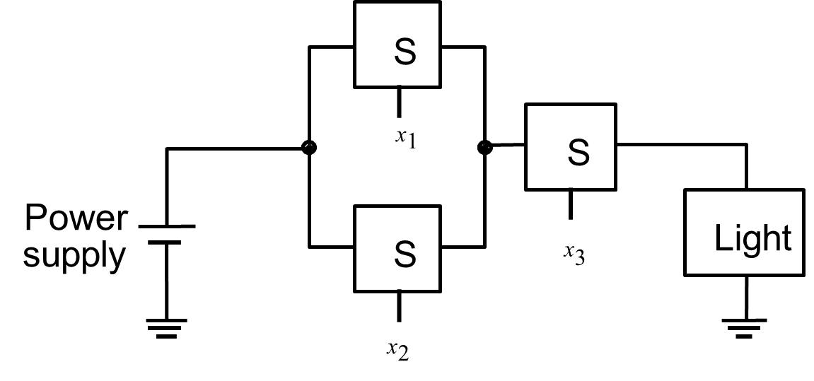
Example
A Series Parallel Circuit

Slide 7
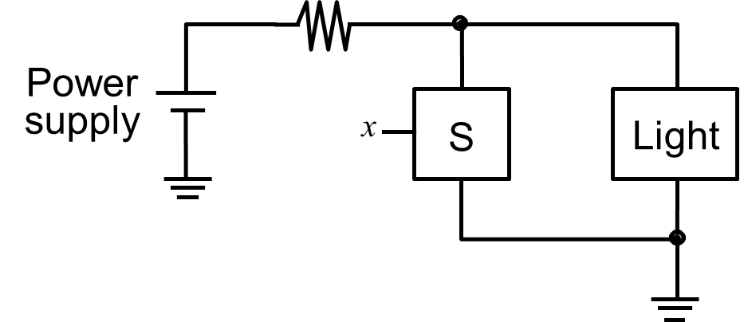
NOT
An Inverting Circuit

Slide 8
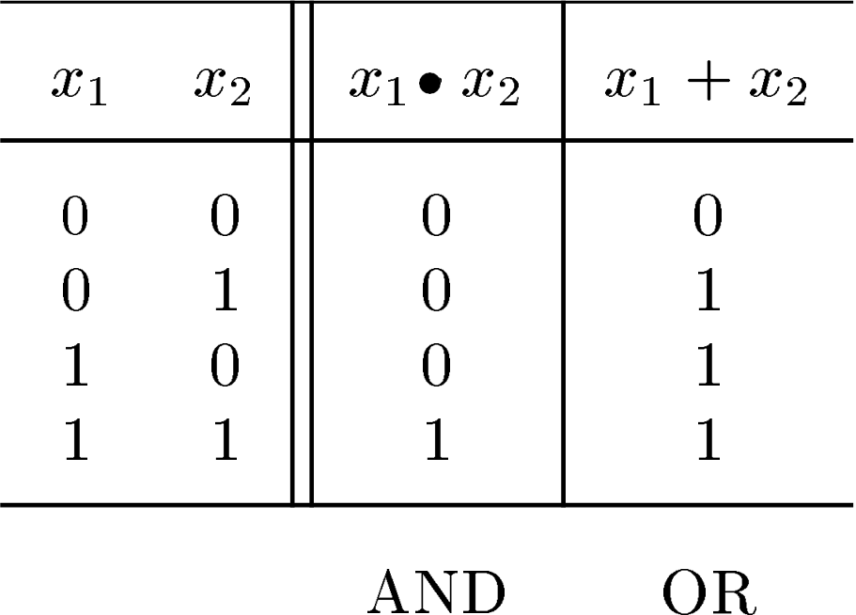
Truth Table

Slide 9
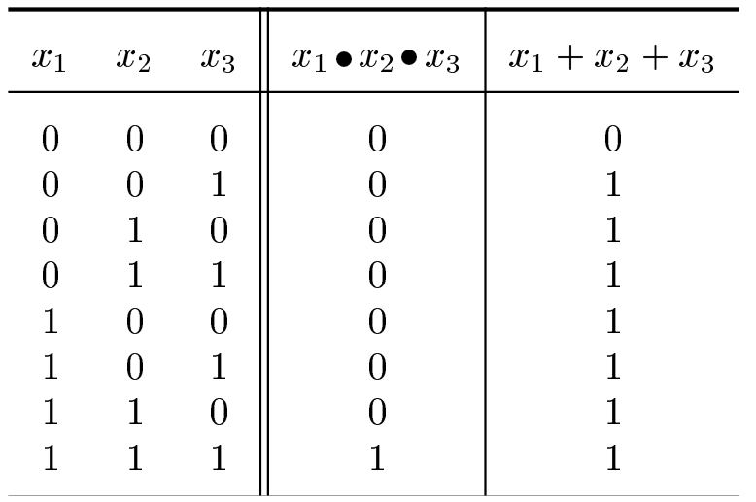
Truth Table
3-Input AND and OR Operations

Slide 10
Symbols
AND
Dot ( )
Imagine it to be like multiplication
Example x y
Called “x and y”
OR
Plus ( + )
Imagine it to be like addition
Example x+y
Called “x or y”

Slide 11
Symbols
NOT
Closing single quote ’
Also over-line and ! symbol
Example: x’, x, !x
Calling
x complement
“not of x”
Simpler: “x bar”

Slide 12
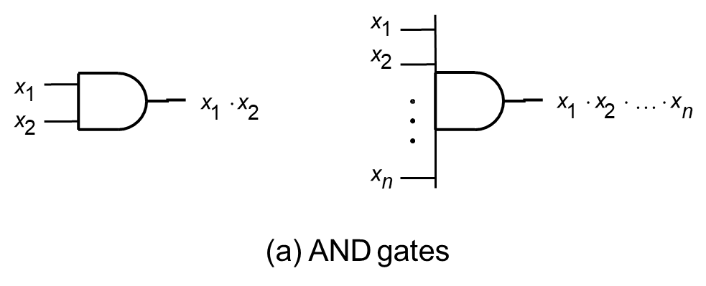
Symbols

Slide 13
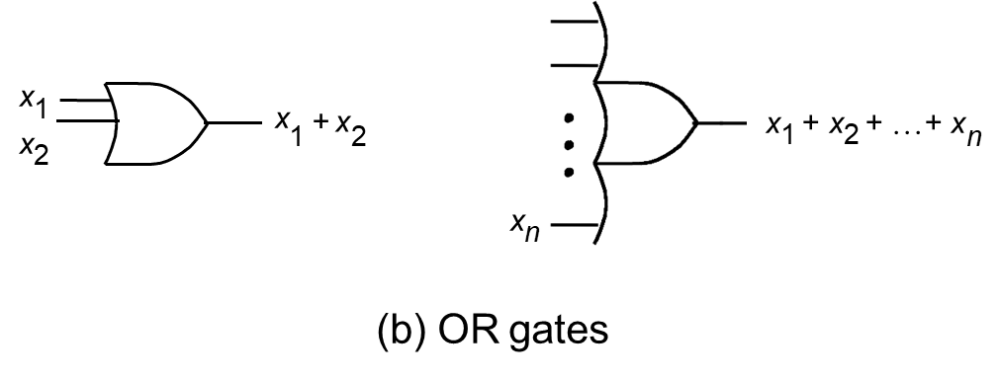
Symbols

Slide 14
Symbols
x
x
(c) NOT gate

Slide 15
Boolean Algebra
Named after George Boole
Axioms
0 · 0 = 0
0 + 0 = 0
0’ = 1
Duality
1 · 1 =1
1 + 1 = 1
1’ = 0
0 + 1 = 1 + 0 = 1
0·1 = 1·0 = 0

Slide 16
Single Variable Theorems
x | · | 0 | = 0
x | + | 1 | = 1
x | · | 1 | = x
x | + | 0 | = x
x | · | x | = x
x | + | x | = x
x | + | !x | = 1
x | · | !x | = 0
x | · | x | x · … x = x
!!x = x

Slide 17
Two Variable Theorems
x | · | y | = | y | · | x
x | + | y | = | y | + | x
Both are commutative

Slide 18
Three Variable Theorems
Associative Laws
x | · | (y | z) | = | (x | · | y) | · | z
x | + | (y | + z) | = | (x | + | y) | + | z
Distributive Law
x · (y + z) = (x
· y) + (x · z)
x + (y · z) = (x + y) · (x + z)

Slide 19
DeMorgan’s Theorem
(X₁ + X₂ + ... + X_{n} ) = X₁ ⋅ X₂ ⋅ ... ⋅ X_{n}
(X₁ ⋅ X₂ ⋅ ... ⋅ X_{n} )
= X₁ + X₂ + ... + X_{n}
Note that
X ⋅Y ≠ X ⋅Y
X + Y ≠ X + Y

